Slide 1
N. K. Orchid College Of Engineering & Technology, Solapur.
Deptartment of
Computer Science & Engineering
Presentation
on
<Financial Website>
Presented by
1. Rohan Konkatti
2. Tejas Choudhari
3. Abhishek Dandi
4. Onkar Charkupalli

Slide 2
CONTENTS
Introduction of the Project.
Objective of Project.
Functional requirement
Prototype(Mock UI).
Chabot/web/APP/unit
Conclusion

Slide 3
INTRODUCTION
Online Investment Guide.
One stop destination for all Information.

Slide 4
Functional Requirement
Responsive Webpage.
Mobile First Approach.
Home Page.
Embedded youtube videos.
Contact.

Slide 5
Objective(Need of Project)
Scope Of Stock Market.
Lack of Financial Knowledge.
Improper information.

Slide 6
UI MockUP

Slide 7
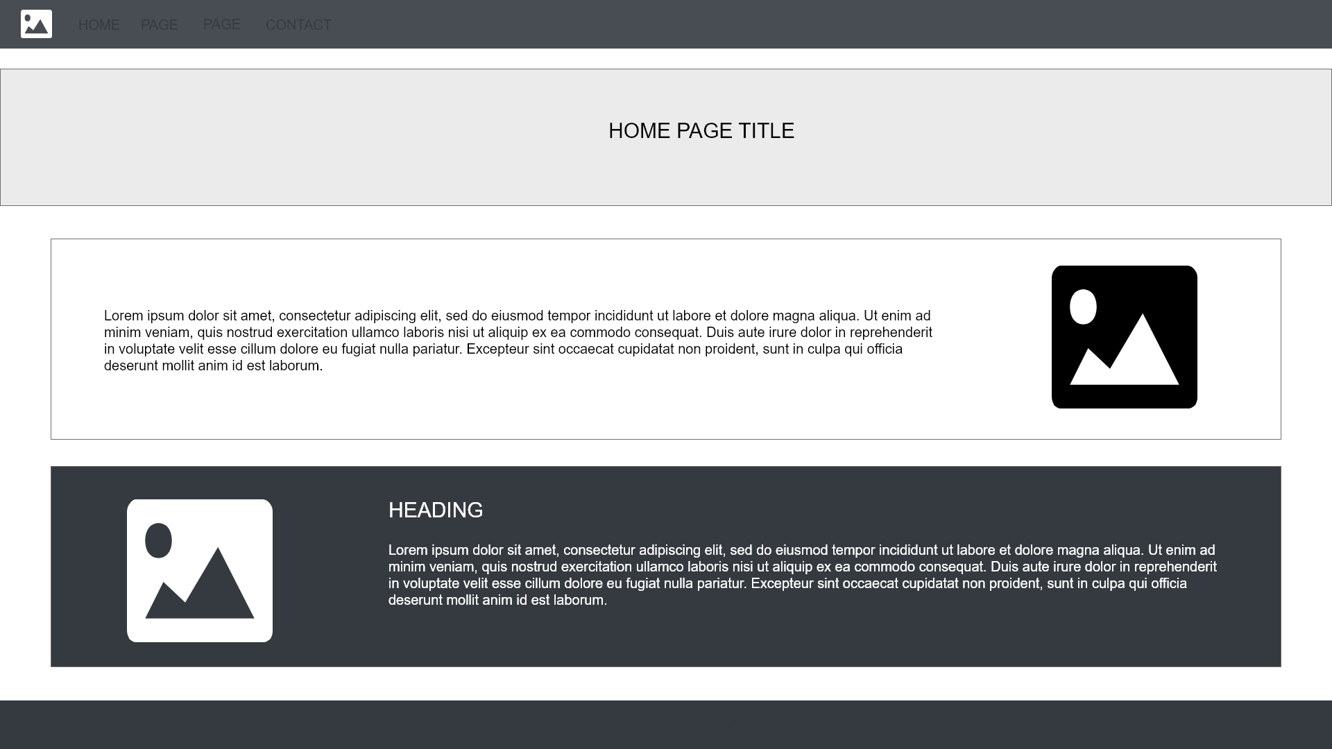
HOMEPAGE MockUP

Slide 8
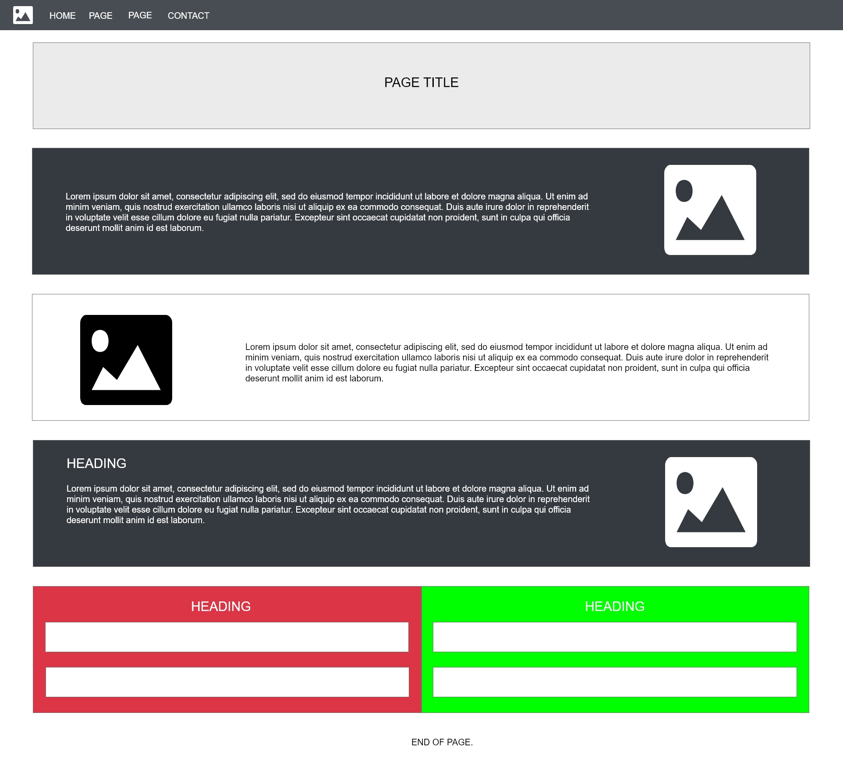
WEBPAGE MockUP

Slide 9
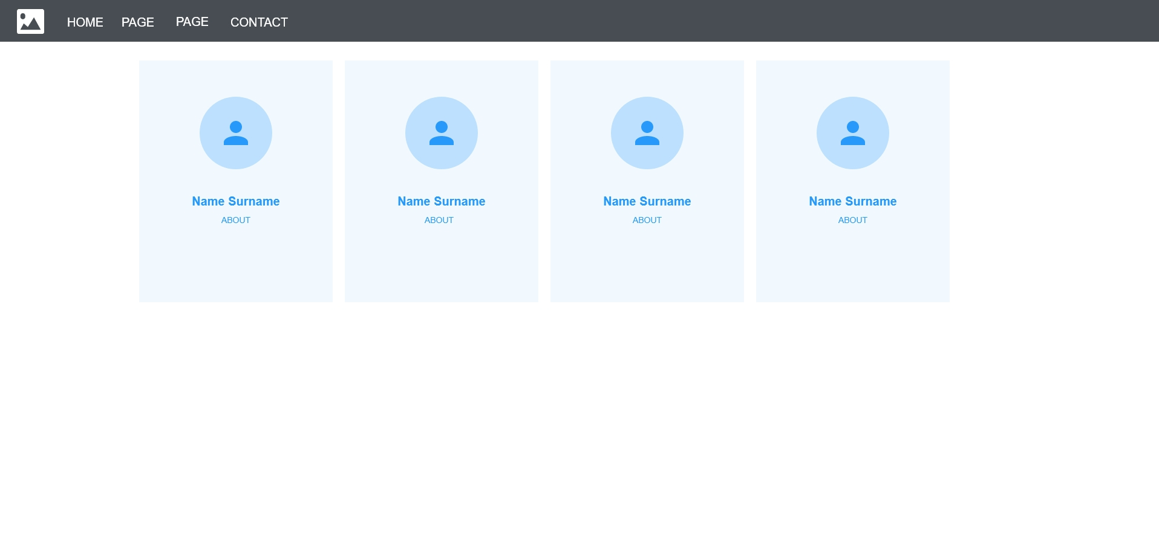
CONTACT PAGE MockUP

Slide 10
Demonstration
Web Page

Slide 11
Applications
Quick Information
Tabular Data Of Stocks.

Slide 12
Conclusion

Slide 13
THANK YOU…

